Slide 1

Principles of Economics (1 of 2)
Thirteenth Edition
Part 1
Introduction to Economics
Copyright © 2020, 2016, 2011 Pearson Education, Inc. All Rights Reserved
Notes:
If this PowerPoint presentation contains mathematical equations, you may need to check that your computer has the following installed:
1) MathType Plugin
2) Math Player (free versions available)
3) NVDA Reader (free versions available)

Slide 2
Principles of Economics (2 of 2)
Thirteenth Edition
Chapter 1
The Scope and Method of Economics
Copyright © 2020, 2016, 2011 Pearson Education, Inc. All Rights Reserved

Slide 3
Chapter Outline and Learning Objectives (1 of 2)
1.1 Why Study Economics?
Identify three key reasons to study economics. Think of an example from your life in which understanding opportunity costs or the principle of efficient markets could make a difference in your decision making.
1.2 The Scope of Economics
Describe microeconomics, macroeconomics, and the diverse fields of economics.

Slide 4
Chapter Outline and Learning Objectives (2 of 2)
1.3 The Method of Economics
Think about an example of bad causal inference leading to erroneous decision making. Identify the four main goals of economic policy.
1.4 Economic Skills and Economics as a Career
Describe economics as a career and the key skills you can learn from studying economics.
Appendix: How to Read and Understand Graphs
Understand how data can be graphically represented.

Slide 5
Chapter 1 The Scope and Method of Economics
economics The study of how individuals and societies choose to use the scarce resources that nature and previous generations have provided.
The key word in the definition is choose.
Economics is a behavioral, or social, science.
Economics is the study of how people make choices.

Slide 6
Why Study Economics?
To Learn a Way of Thinking
Economics has three fundamental concepts:
Opportunity Cost
Marginalism
Efficient Markets

Slide 7
To Learn a Way of Thinking (1 of 3)
Opportunity Cost
opportunity cost The best alternative that we forgo, or give up, when we make a choice or decision.
scarce Limited.

Slide 8
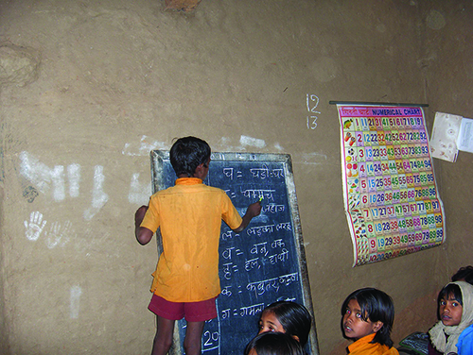
Economics In Practice (1 of 4)
Rainfall and Schooling in India
Much of India is still rural and dependent on agriculture.
When rains are plentiful, the opportunity cost of sending children to school—the loss in current agricultural output—increases.
Using data from more than 2 million children ages 5–16 across rural India, economists find that an unusually high rainfall reduces school enrollments and thus lower math test scores.
CRITICAL THINKING
For urban children in India, work opportunities are few. What would you expect to see happen to the urban-rural gap in test scores in high rainfall periods?

Slide 9
To Learn a Way of Thinking (2 of 3)
Marginalism
marginalism The process of analyzing the additional or incremental costs or benefits arising from a choice or decision.

Slide 10
To Learn a Way of Thinking (3 of 3)
Efficient Markets—No Free Lunch
efficient market A market in which profit opportunities are eliminated almost instantaneously.
The study of economics teaches us a way of thinking and helps us make decisions.

Slide 11

Economics In Practice (2 of 4)
Majoring in Economics Makes You Less Vulnerable to a Recession!
It is well known that economics is, along with engineering, one of the majors with the highest wage premia.
Recent work has also shown that majors like economics are less hurt by graduating in a recession than sociology or journalism.
CRITICAL THINKING
What types of jobs do economics major typically go into?

Slide 12
To Understand Society
Industrial Revolution The period in England during the late eighteenth and early nineteenth centuries in which new manufacturing technologies and improved transportation gave rise to the modern factory system and a massive movement of the population from the countryside to the cities.
The study of economics is an essential part of the study of society.

Slide 13
To Be an Informed Citizen
To be an informed citizen requires a basic understanding of economics.

Slide 14
The Scope of Economics (1 of 2)
Microeconomics and Macroeconomics
microeconomics The branch of economics that examines the functioning of individual industries and the behavior of individual decision-making units—that is, firms and households.
macroeconomics The branch of economics that examines the economic behavior of aggregates—income, employment, output, and so on—on a national scale.

Slide 15

Economics In Practice (3 of 4)
iPod and the World
A sticker that says “Made in China” can often be misleading.
The iPod is composed of many small parts, and it is almost impossible to accurately tell exactly where each piece was produced without pulling it apart.
From an economics point of view, one often has to dig deep to see what is really going on.
CRITICAL THINKING
What do you think accounts for where components of the iPod and Barbie are made?

Slide 16
The Scope of Economics (2 of 2)
Microeconomics and Macroeconomics
Microeconomics looks at the individual unit—the household, the firm, the industry. It sees and examines the “trees.”
Macroeconomics looks at the whole, the aggregate. It sees and analyzes the “forest.”

Slide 17
Table 1.1 Examples of Microeconomic and Macroeconomic Concerns
Division of Economics | Production | Prices | Income | Employment
Microeconomics | Production/output in individual industries and businesses How much steel How much office space How many cars | Prices of individual goods and services Price of medical care Price of gasoline Food prices Apartment rents | Distribution of income and wealth Wages in the auto industry Minimum wage Executive salaries Poverty | Employment by individual businesses and industries Jobs in the steel industry Number of employees in a firm Number of accountants
Macroeconomics | National production/output Total industrial output Gross domestic product Growth of output | Aggregate price level Consumer prices Producer prices Rate of inflation | National income Total wages and salaries Total corporate profits | Employment and unemployment in the economy Total number of jobs Unemployment rate

Slide 18
Table 1.2 The Fields of Economics (1 of 3)
Behavioral economics | Do aggregate household savings increase when we automatically enroll people in savings programs and let them opt out as opposed to requiring them to sign up?
Comparative economic systems | How does the resource allocation process differ in market versus command and control systems?
Econometrics | What inferences can we make based on conditional moment inequalities?
Economic development | Does increasing employment opportunities for girls in developing nations increase their educational achievements?
Economic history | How did the growth of railroads and improvement in transportation more generally change the U.S. banking systems in the nineteenth century?

Slide 19
Table 1.2 The Fields of Economics (2 of 3)
Environmental economics | What effect would a tax on carbon have on emissions? Is a tax better or worse than rules?
Finance | Is high frequency trading socially beneficial?
Health economics | Do co-pays by patients change the choice and use of medicines by insured patients?
The history of economic thought | How did Aristotle think about just prices?
Industrial organization | How do we explain price wars in the airline industry?

Slide 20
Table 1.2 The Fields of Economics (3 of 3)
International economics | What are the benefits and costs of free trade? Does concern about the environment change our views of free trade?
Labor economics | Will increasing the minimum wage decrease employment opportunities?
Law and economics | Does the current U.S. patent law increase or decrease the rate of innovation?
Public economics | Why is corruption more widespread in some countries than in others?
Urban and regional economics | Do enterprise zones improve employment opportunities in central cities?

Slide 21
The Method of Economics
Economics deals with two kinds of questions: positive and normative.
positive economics An approach to economics that seeks to understand behavior and the operation of systems without making judgments. It describes what exists and how it works.
normative economics An approach to economics that analyzes outcomes of economic behavior, evaluates them as good or bad, and may prescribe courses of action. Also called policy economics.

Slide 22
Theories and Models (1 of 5)
model A formal statement of a theory, usually a mathematical statement of a presumed relationship between two or more variables.
variable A measure that can change from time to time or from observation to observation.
Ockham’s razor The principle that irrelevant detail should be cut away.

Slide 23
Theories and Models (2 of 5)
All Else Equal
ceteris paribus or all else equal A device used to analyze the relationship between two variables while the values of other variables are held unchanged.
Using the device of ceteris paribus is one part of the process of abstraction.
In formulating economic theory, the concept helps us simplify reality to focus on the relationships that interest us.

Slide 24
Theories and Models (3 of 5)
Expressing Models in Words, Graphs, and Equations
Graphs and equations capture the quantitative side of economic observations and predictions.

Slide 25
Theories and Models (4 of 5)
Cautions and Pitfalls
Economists are interested in cause and effect, but sorting out causality from correlation is not always easy.
post hoc, ergo propter hoc Literally, “after this (in time), therefore because of this.” A common error made in thinking about causation: If Event A happens before Event B, it is not necessarily true that A caused B.

Slide 26
Theories and Models (5 of 5)
Testing Theories and Models: Empirical Economics
empirical economics The collection and use of data to test economic theories.

Slide 27

Economics In Practice (4 of 4)
Does Your Roommate Matter for Your Grades?
Several studies of the effect of roommates on college grades help to sort out causality in peer effects.
One study looked at randomly assigned freshman roommates in one college to test the peer effects from different types of roommates.
The author found strong roommate effects on grade point average, effort in school, and fraternity membership.
CRITICAL THINKING
Would you expect college seniors who choose their own roommates to have more or less similar grades than college freshmen who are assigned as roommates? Why or why not?

Slide 28
Economic Policy (1 of 3)
Four criteria are important in judging economic outcomes:
Efficiency
Equity
Growth
Stability

Slide 29
Economic Policy (2 of 3)
Efficiency
efficiency In economics, efficiency means allocative efficiency. An efficient economy is one that produces what people want at the least possible cost.
Equity
equity Fairness.

Slide 30
Economic Policy (3 of 3)
Growth
economic growth An increase in the total output of an economy.
Stability
stability A condition in which national output is growing steadily, with low inflation and full employment of resources.

Slide 31
An Invitation
You cannot begin to understand how a society functions without knowing something about its economic history and its economic system.
Learning to think in this very powerful way will help you better understand the world.
This book proceeds step-by-step, each section building on the last.
Make sure you understand where it all fits in the big picture.

Slide 32
Economic Skills and Economics as a Career
We will explore economic principles that you will find very useful in understanding what is happening in the world of economics and business and in your everyday life.
Individuals, business managers, and government policymakers use economic principles to improve how they make important decisions.
Whether or not you pursue a career in economics, you can still benefit from the skills learned by taking economics classes.

Slide 33
Review Terms and Concepts
ceteris paribus, or all else equal
economic growth
economics
efficiency
efficient market
empirical economics
equity
Industrial Revolution
macroeconomics
Marginalism
microeconomics
model
normative economics
Ockham’s razor
opportunity cost
positive economics
post hoc, ergo propter hoc
scarce
stability
variable

Slide 34
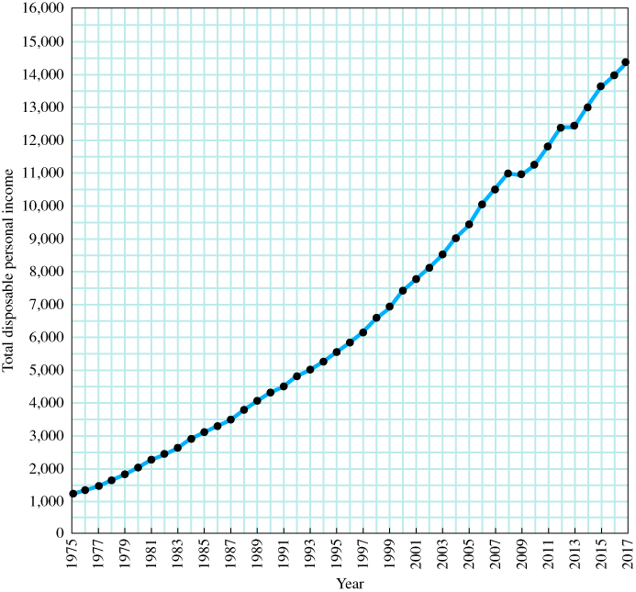
Table 1A.1 Total Disposable Personal Income in the United States, 1975–2017 (in billions of dollars)
Figure 1A.1 Total Disposable Personal Income in the United States: 1975–2017 (in billions of dollars)
Year | Total Disposable Personal Income | Year | Total Disposable Personal Income | Year | Total Disposable Personal Income
1975 | 1,219 | 1991 | 4,485 | 2007 | 10,507
1976 | 1,326 | 1992 | 4,800 | 2008 | 10,994
1977 | 1,457 | 1993 | 5,000 | 2009 | 10,943
1978 | 1,630 | 1994 | 5,244 | 2010 | 11,238
1979 | 1,809 | 1995 | 5,533 | 2011 | 11,801
1980 | 2,018 | 1996 | 5,830 | 2012 | 12,404
1981 | 2,251 | 1997 | 6,149 | 2013 | 12,396
1982 | 2,425 | 1998 | 6,561 | 2014 | 13,033
1983 | 2,617 | 1999 | 6,876 | 2015 | 13,615
1984 | 2,904 | 2000 | 7,401 | 2016 | 13,969
1985 | 3,099 | 2001 | 7,752 | 2017 | 14,379
1986 | 3,288 | 2002 | 8,099
1987 | 3,466 | 2003 | 8,466
1988 | 3,770 | 2004 | 9,002
1989 | 4,052 | 2005 | 9,401
1990 | 4,312 | 2006 | 10,037
Source: See Table 1A.1.
Source: U.S. Department of Commerce,
Bureau of Economic Analysis.

Slide 35
Graphing Two Variables
X-axis The horizontal line against which a variable is plotted.
Y-axis The vertical line against which a variable is plotted.
origin The point at which the horizontal and vertical axes intersect.
Y-intercept The point at which a graph intersects the Y-axis.
X-intercept The point at which a graph intersects the X-axis.

Slide 36
Plotting Income and Consumption Data for Households
positive relationship A relationship between two variables, X and Y, in which a decrease in X is associated with a decrease in Y and an increase in X is associated with an increase in Y.
negative relationship A relationship between two variables, X and Y, in which a decrease in X is associated with an increase in Y and an increase in X is associated with a decrease in Y.

Slide 37
Table 1A.2 Consumption Expenditures and After-Tax Income, 2016
Blank | Average After-Tax Income | Average Consumption Expenditures
Bottom fifth | $ 11,832 | $ 25,138
2nd fifth | 29,423 | 36,770
3rd fifth | 47,681 | 47,664
4th fifth | 75,065 | 64,910
Top fifth | 157,215 | 112,221
Source: Consumer Expenditures in 2016, U.S. Bureau of Labor Statistics.

Slide 38
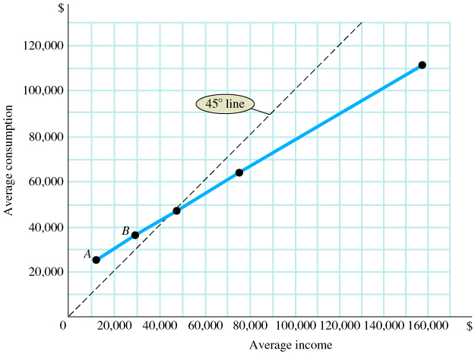
Figure 1A.2 Household Consumption and Income
A graph is a simple two-dimensional geometric representation of data. The graph in Figure 1A.2 displays the data from Table 1A.2.
Along the horizontal scale (X-axis), we measure household income. Along the vertical scale (Y-axis), we measure household consumption.
Source: See Table 1A.2.
Note: At point A, consumption equals $25,138 and income equals $11,832. At point B, consumption equals $36,770 and income equals $29,423.

Slide 39
Slope
slope A measurement that indicates whether the relationship between variables is positive or negative and how much of a response there is in Y (the variable on the vertical axis) when X (the variable on the horizontal axis) changes.

Slide 40
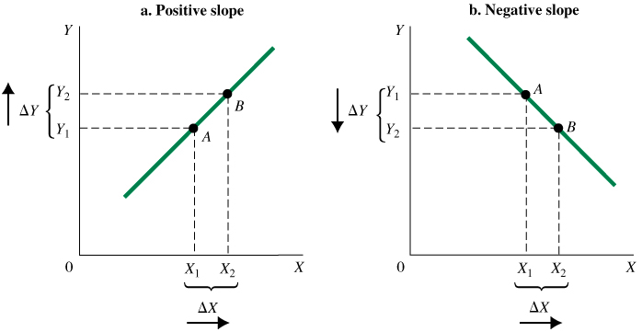
Figure 1A.3 A Curve with (a) Positive Slope and (b) Negative Slope
A positive slope indicates that increases in X are associated with increases in Y and that decreases in X are associated with decreases in Y.
A negative slope indicates the opposite—when X increases, Y decreases; and when X decreases, Y increases.

Slide 41
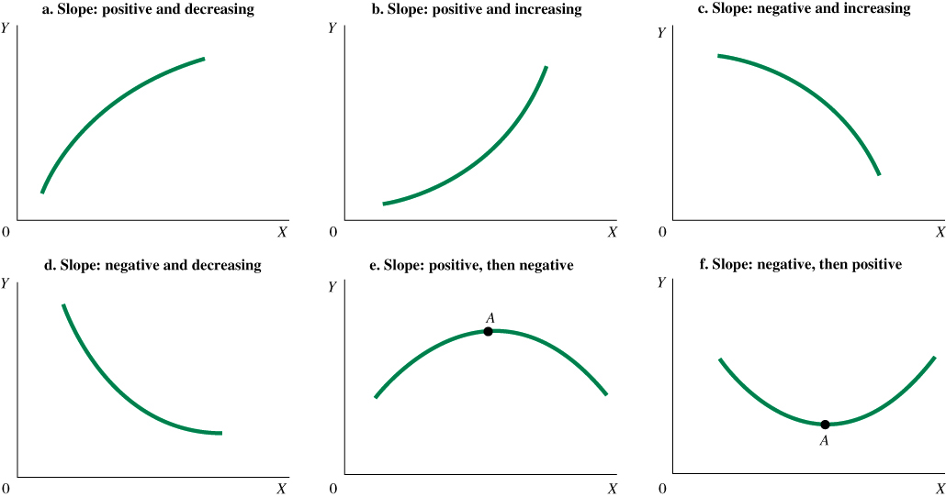
Figure 1A.4 Changing Slopes along Curves

Slide 42
Some Precautions (1 of 2)
Blank | Total Disposable Personal Income | Total Consumption
1930 | 75 | 70
1940 | 78 | 71
1950 | 215 | 192
1960 | 377 | 332
1970 | 762 | 648
1980 | 2,018 | 1,755
1990 | 4,312 | 3,826
2000 | 7,401 | 6,792
2010 | 11,238 | 10,202
2011 | 11,801 | 10,689
2012 | 12,404 | 11,051
2013 | 12,396 | 11,361
2014 | 13,033 | 11,928
2015 | 13,615 | 12,332
2016 | 13,969 | 12,821
2017 | 14,379 | 13,396
Table 1A.3 Total Disposable Personal Income and Consumption for the United States, 1930–2017 (in billions of dollars)
Source: U.S. Department of Commerce, Bureau of Economic Analysis.

Slide 43
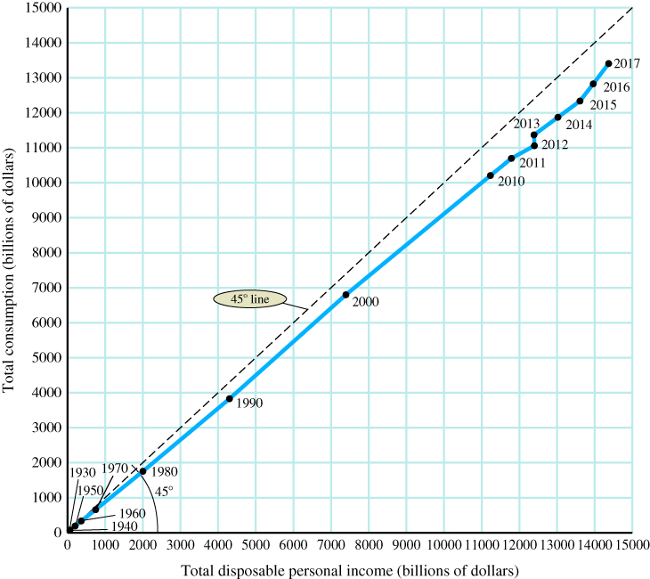
Some Precautions (2 of 2)
Figure 1A.5 Disposable Personal Income and Consumption
It is important to think carefully about what is represented by points in the space defined by the axes of a graph.
In Figure 1A.5 we have graphed income with consumption, as in Figure 1A.2, but here each observation point is total disposable income and total consumption in different years, measured in billions of dollars.
Source: See Table 1A.3.

Slide 44
Appendix Review Terms and Concepts
graph
negative relationship
origin
positive relationship
Slope
time series graph
X-axis
X-intercept
Y-axis
Y-intercept

Slide 45
Copyright
This work is protected by United States copyright laws and is provided solely for the use of instructors in teaching their courses and assessing student learning. Dissemination or sale of any part of this work (including on the World Wide Web) will destroy the integrity of the work and is not permitted. The work and materials from it should never be made available to students except by instructors using the accompanying text in their classes. All recipients of this work are expected to abide by these restrictions and to honor the intended pedagogical purposes and the needs of other instructors who rely on these materials.

